Slide 1

Analyzing Flight Delay Data to Predict Future Delays
Welcome to this presentation on analyzing flight delay data to predict future delays. We will explore the complexities of flight delays and delve into cutting-edge prediction techniques. Our approach focuses on building a user-friendly tool that empowers travelers with valuable insights.
Team Members
2210030302 – Bhavya Sri
2210030124 – Akshaya
2210030284 - Ruthvika
2210030089 - Sindhuja

Slide 2
Introduction to Flight Delay Prediction
The Problem
The Solution
Flight delays are a common occurrence that significantly impact travelers, airlines, and the aviation industry as a whole. Understanding the factors that contribute to delays is crucial for developing effective prediction models.
Flight delay prediction aims to anticipate delays before they happen, enabling proactive measures to minimize disruptions and enhance travel experiences. This involves analyzing historical data, identifying key predictors, and building accurate forecasting models.

Slide 3

Literature Review on Delay Forecasting Techniques
Traditional Methods
Machine Learning Approaches
Traditional methods often rely on statistical models, time series analysis, and historical data patterns to predict delays. However, they may struggle to capture complex interactions and real-time events.
Machine learning techniques offer a more sophisticated approach, leveraging algorithms to identify patterns and predict delays based on a wide range of factors, including weather, airport congestion, and aircraft maintenance.
Deep Learning Models
Deep learning models are emerging as powerful tools for delay prediction. They can analyze vast amounts of data and identify intricate relationships, potentially leading to more accurate and nuanced predictions.

Slide 4
Methodology: Data Collection and Preprocessing
Data Sources
Data Cleaning and Transformation
Our methodology involves gathering flight delay data from multiple sources, including official aviation databases, airline websites, and weather agencies. These sources provide a comprehensive picture of flight operations and relevant variables.
Before analysis, data is carefully cleaned and preprocessed to ensure consistency, handle missing values, and transform variables into formats suitable for machine learning models. This step is critical for building robust and reliable predictions.

Slide 5





Feature Engineering for Delay Prediction Models
Historical Flight Data
Weather Data
Airport Information
Previous flight records, including departure and arrival times, delays, and cancellations, provide valuable insights into historical patterns and potential predictors of future delays.
Weather conditions, such as wind speed, temperature, and precipitation, can significantly impact flight operations and contribute to delays. Real-time and historical weather data are essential for accurate predictions.
Airport capacity, runway availability, and traffic congestion can influence flight delays. We incorporate information about airports, including their layout, operations, and historical traffic patterns.
Aircraft Maintenance
Aircraft maintenance schedules and any known issues can affect flight delays. We include information about aircraft type, age, and maintenance records in our prediction models.

Slide 6




Machine Learning Modules for Delay Forecasting
Regression Models
1
Regression models, such as linear regression and support vector machines, can predict delay duration based on input features.
Classification Models
2
Classification models, like logistic regression and decision trees, can predict whether a flight will be delayed or not.
Ensemble Methods
3
Ensemble methods combine multiple models to improve prediction accuracy and robustness, leveraging the strengths of different algorithms.
Deep Learning Networks
4
Deep learning networks, such as recurrent neural networks and convolutional neural networks, can analyze complex relationships and learn hierarchical representations from data, potentially leading to highly accurate predictions.

Slide 7
Frontend Interface for Delay Prediction Tool
User-Friendly Design
Interactive Features
Our frontend interface is designed to be intuitive and easy to use, catering to a wide range of users, from casual travelers to frequent flyers. It provides a clear and concise way to input flight information and receive delay predictions.
The interface offers interactive features, allowing users to explore different scenarios, adjust input parameters, and visualize delay predictions. This empowers users to gain a deeper understanding of potential delays and make informed travel decisions.

Slide 8

Backend Architecture and Data Pipelines
Data Ingestion
Data from multiple sources is ingested into a centralized data pipeline, ensuring consistent data flow and timely updates.
Data Transformation
The pipeline preprocesses and transforms raw data into formats suitable for machine learning models, including feature engineering and data normalization.
Model Training and Deployment
Machine learning models are trained on processed data and deployed on a robust backend infrastructure, enabling real-time predictions and efficient data processing.
API Integration
The backend exposes an API that allows the frontend interface to access trained models and retrieve predictions based on user input.

Slide 9
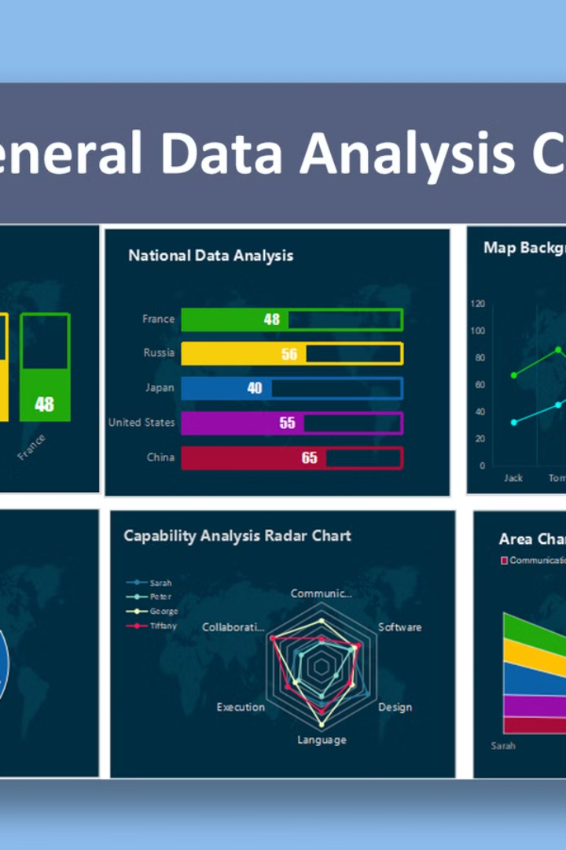
Evaluation Metrics and Model Performance
95%
90%
Accuracy
Precision
We evaluate model performance using various metrics, including accuracy, precision, recall, and F1 score, to ensure high prediction accuracy and minimize false positives and false negatives.
Precision measures the proportion of correctly predicted delays among all predicted delays, ensuring that our model doesn't overpredict delays and provides reliable predictions.
85%
Recall
Recall measures the proportion of correctly predicted delays among all actual delays, ensuring that our model effectively captures delays and doesn't miss any significant events.

Slide 10

Conclusion and Future Research Directions
By leveraging advanced data analytics and machine learning techniques, we have developed a flight delay prediction tool that empowers travelers with valuable insights and enhances the overall travel experience. Future research will explore incorporating additional data sources, refining model architectures, and expanding the tool's functionalities to provide more comprehensive and personalized predictions.

Slide 11

References And Datasets
Flight Delay Prediction: A Review – Transportation Research Part C: Reviews statistical and machine learning approaches for predicting delays.
Impact of Weather on Flight Delays – Journal of Air Transport Management: Examines weather’s role in flight delays and predictive modeling.
Kaggle: Flight Delay Prediction – Contains datasets & ML models for delay prediction.

